Slide 1
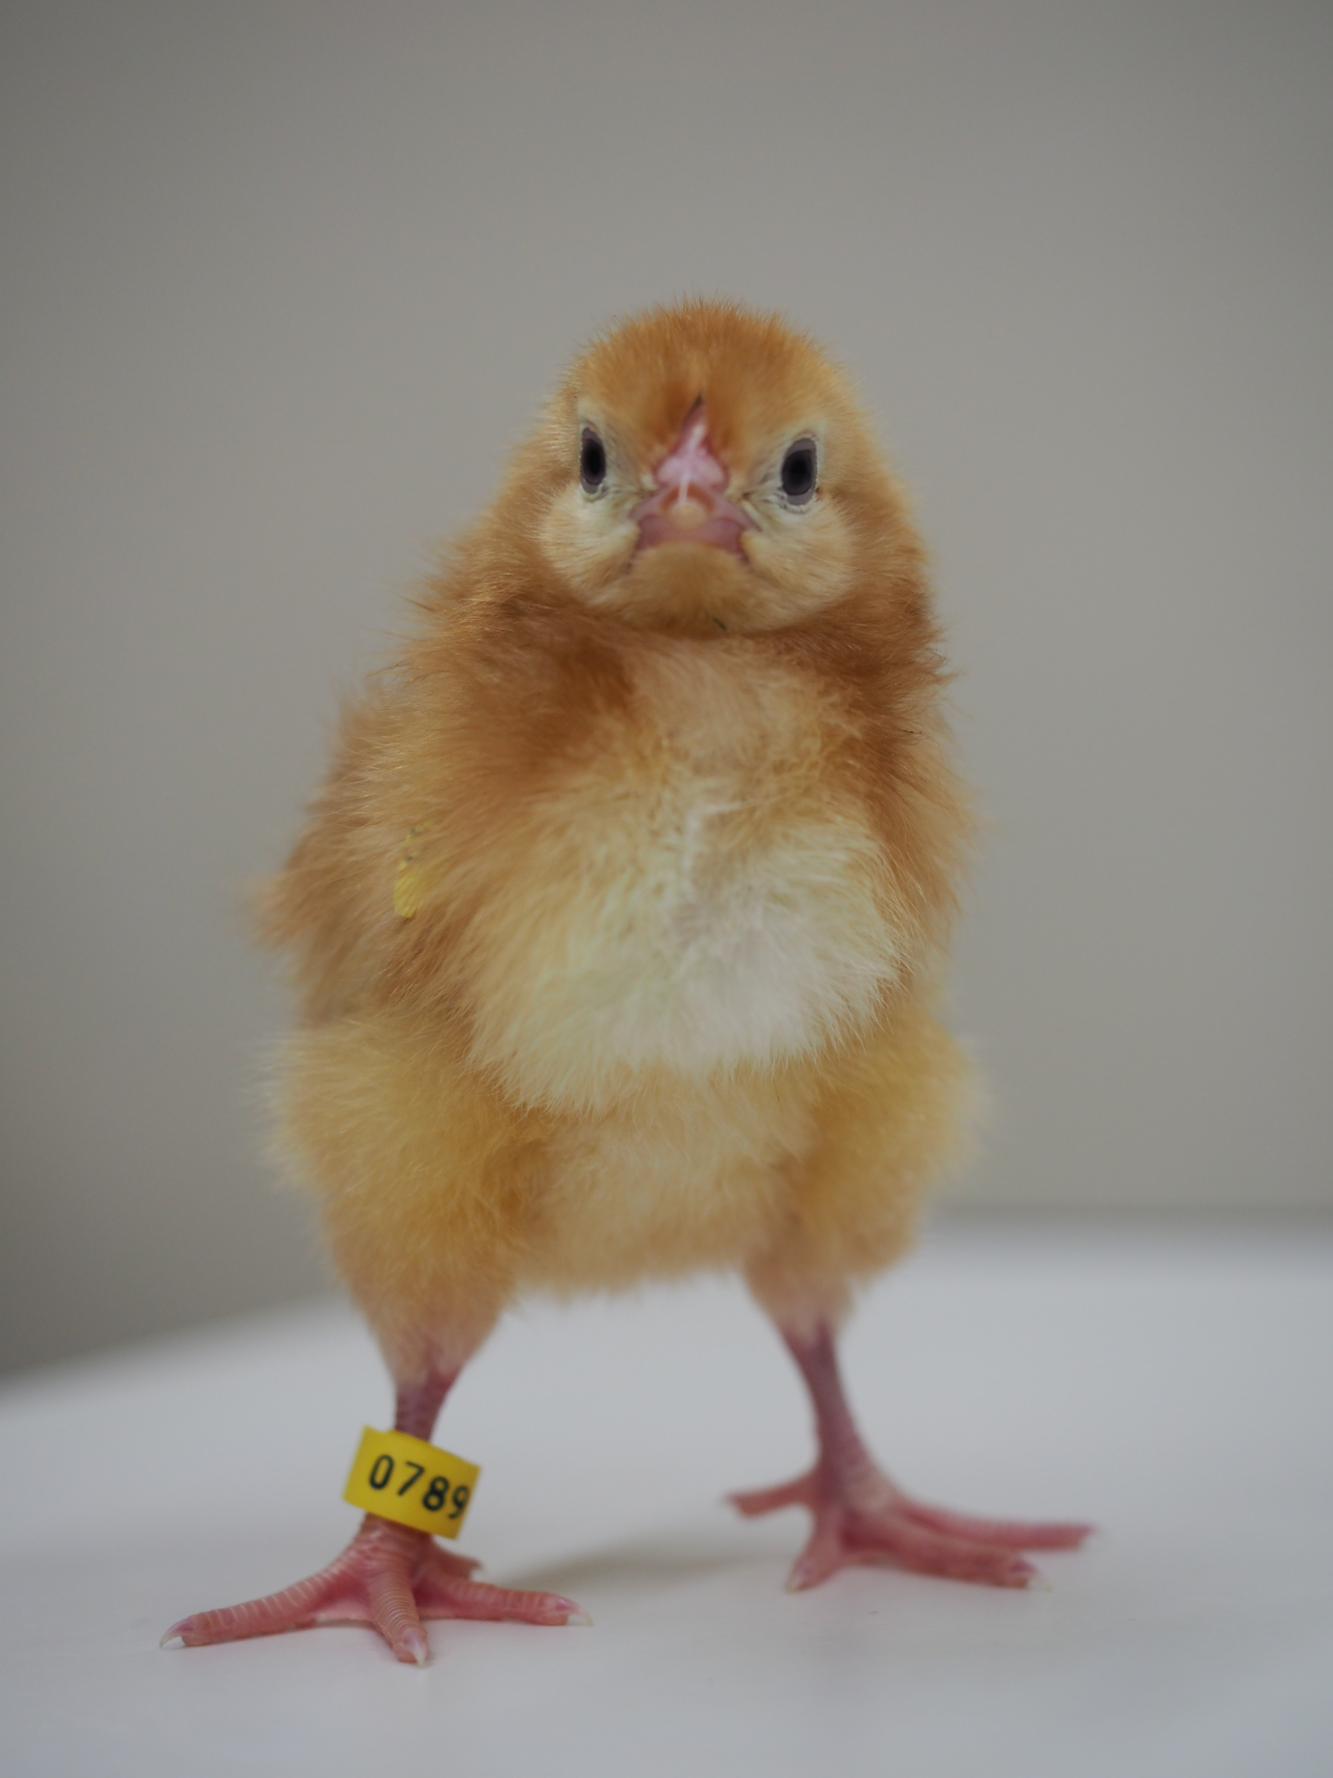
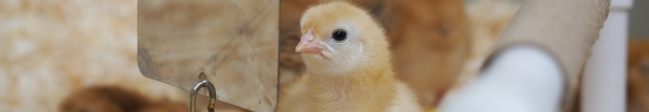
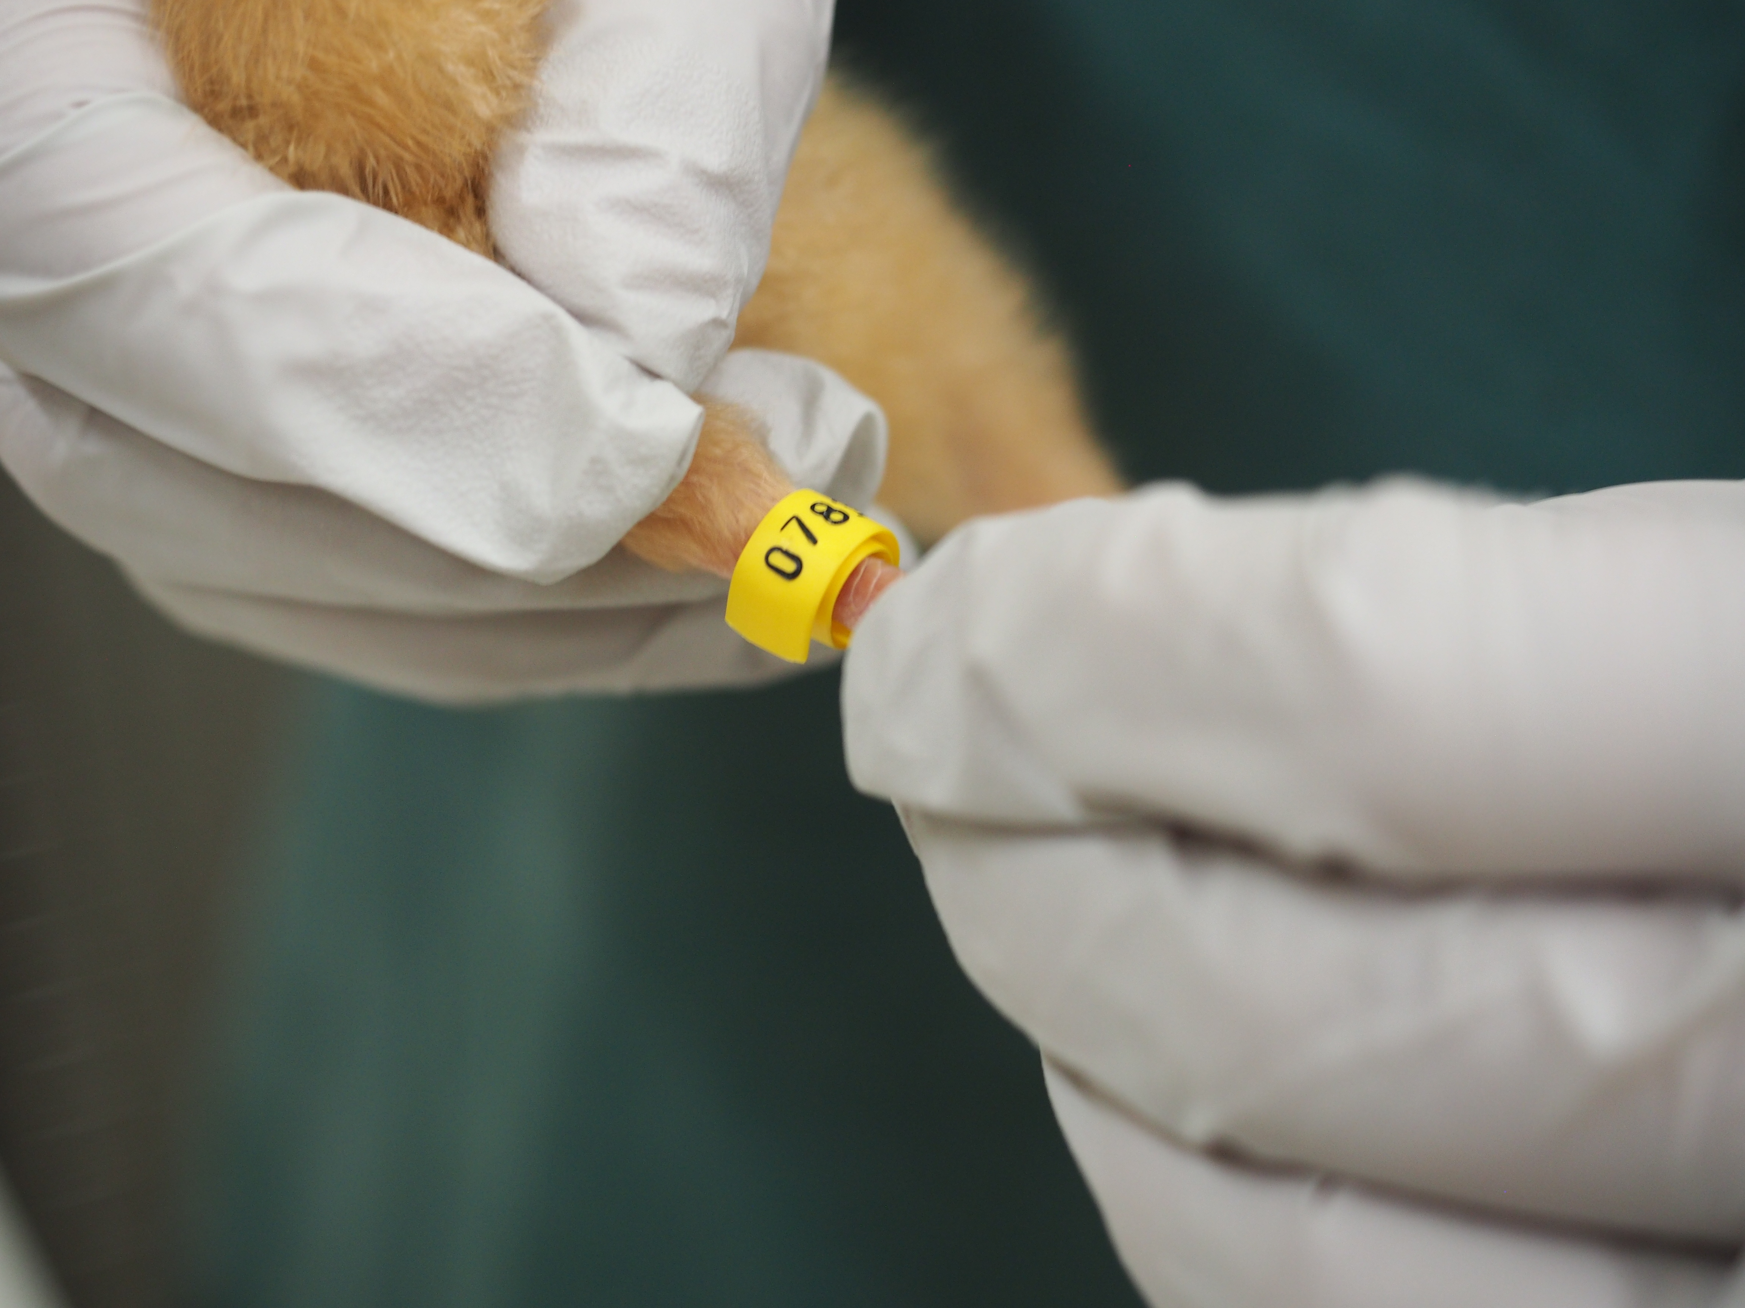
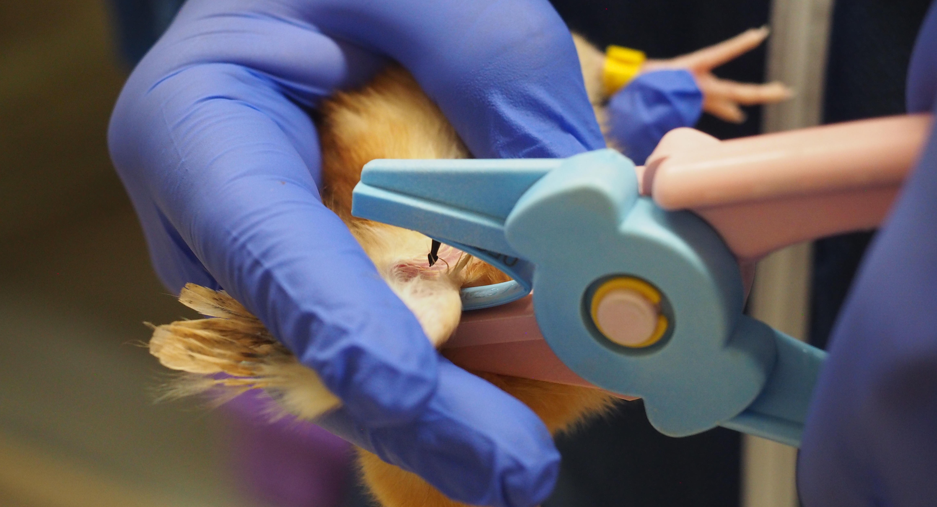
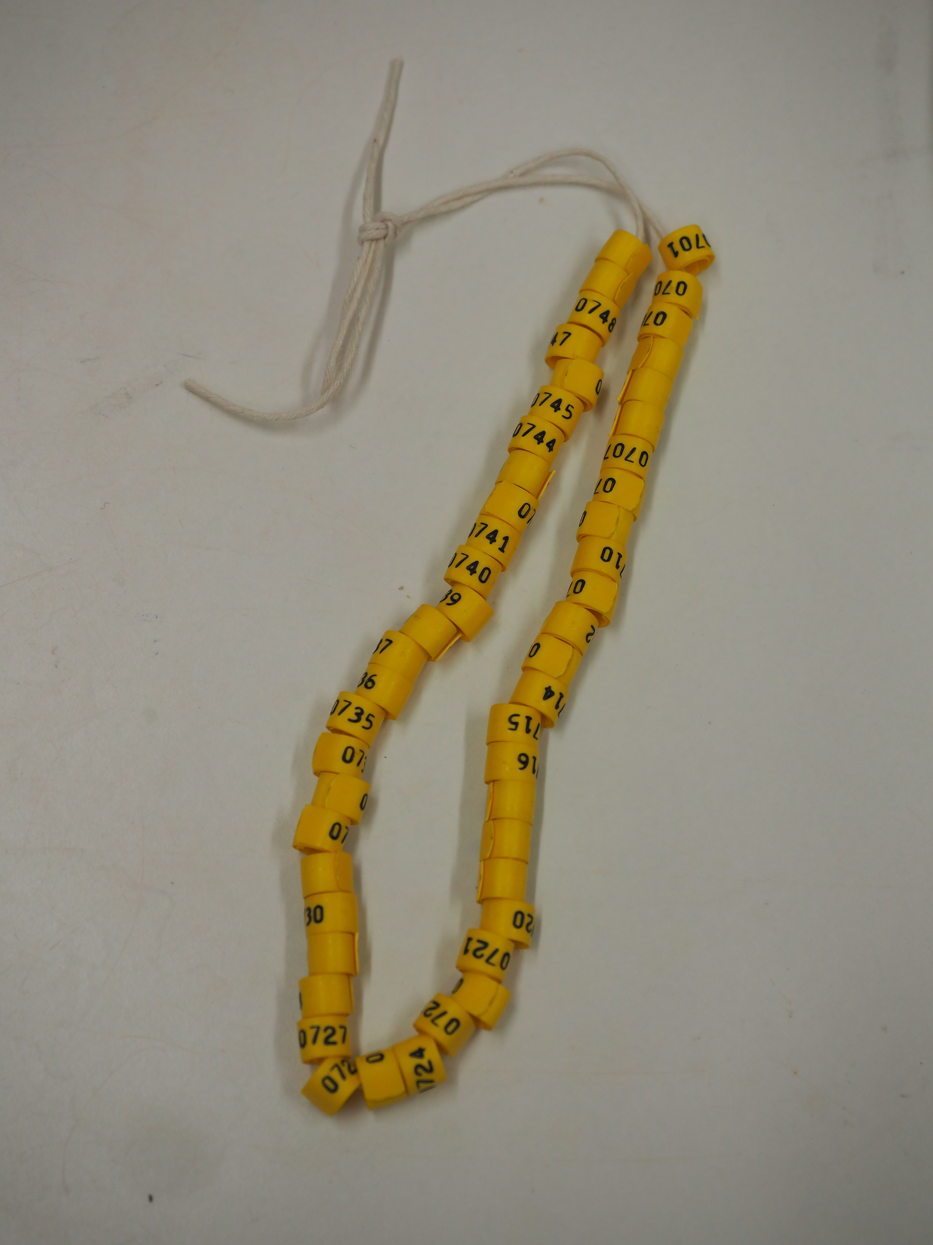





Refining identification methods of gallus gallus domesticus
The Pirbright Institute, Ash Road, Pirbright, Woking, GU24 0NF UK. Tel: +44 (0)1483 232441. Email: enquiries@pirbright.ac.uk www.pirbright.ac.uk
Abstract
Individual identification of birds used in scientific research at The Pirbright Institute has historically used invasive wing tags.
This poster presents the first results of an ongoing study which seeks to replace the wing banding with non-invasive leg bands in a variety of ages of an inbred chicken breed.
Introduction
Individual identification of birds is required when using poultry in infectious disease research. At The Pirbright Institute this has historically been achieved by placing a permanent wing tag through the webbing of an individual wing of day old chicks.
In addition to the invasive nature of this type of ID, other issues have been noted including application in wrong places, rubbing, and growth of feathers in older birds which cover the wing band.
This poster describes the approach and initial results generated at The Pirbright Institute as part of a project attempting to replace the invasive wing band with a plastic leg band.
Methods
Four different leg band designs were assessed against several criteria including:
ease of application adjustment
ID readability
interference with chick mobility
design functionality
cost
Once a leg band design was selected, various sizes were evaluated on day old Rhode Island Red (RIR) chicks, available on a weekly basis. Every day after application, the leg bands on each bird were checked to determine:
How many times they had to be loosened and/or changed
How often the band would fall off
Results
Every week for 6 months, the various sizes of leg bands were assessed on day old chicks to determine the optimal starting size. Preliminary results from the assessment of weekly hatched Rhode Island Red (RIR) chicks indicated that a single 6.4mm leg band (FC2) can be used on birds up to 3 weeks old before the leg band must be replaced. It was observed however that loosening of the leg bands was required; with the majority of this happening between 2 – 3 weeks of age. In the 6 months thus far, no FC2 bands have fallen off chicks up to 3 weeks of age.
It is important to reduce the frequency of leg band replacements to avoid transcription errors.
.
Future
Data will continue to be collected from weekly and study specific hatches. This will be statistically analyzed to determine the optimal leg band size and age at which replacement is necessary for a given chicken breed for differing study lengths. The failure rate of a given size of wing band for a particular breed/age range of chicken will also be determined from this data. Importantly, any difference in effect of wing and leg banding on weight gain will also be examined similar to Dennis et al 2008 with ours being based on plastic leg bands in contrast to their data using metal.
Correlations of leg band replacement events with weight gain and leg diameter will also be determined in order to elucidate which of these two parameters is the most significant. This could be used to predict leg band replacement times for breeds previously unrecorded.
Due to the chicks’ rapid growth rate, it was confirmed that daily checks of the leg band tightness was essential to avoid discomfort to the chicks.
Using this information, a method was developed which detailed the criteria for assessing leg band tightness to standardize the data collected.
The other significant finding was that a single 11mm leg band (FC5) was identified as the largest band which did not fall off from 2 weeks of age. The duration this size can remain on the bird beyond 2 weeks before needing to be replaced will be assessed during study specific hatches which frequently extend beyond 5 weeks of age.
Variability between operators and within an individual operator will also be assessed to determine whether the individual influences the failure rate and frequency of loosening.
References
The Code of Practice for the housing and care of animals bred, supplied or used for scientific purposes
Rings of Distinction- https://www.avianid.co.uk/
Dennis RL, Fahey AG, Cheng HW. Different effects of individual identification systems on chicken well-being. Poult Sci. 2008 Jun;87(6):1052-7. doi: 10.3382/ps.2007-00240. PMID: 18492991
Acknowledgements
The Poultry team for all their hard work collecting data. The chicks for being patient with us.

